Slide 1



AI Voice + Eye Contact + Coding + Linux + Resume Intelligence
InterviewIQ AI
AI-Powered Mock Interview & DevOps Practice Platform
Practice Like a Real Interview, Perform Like a Professional.
Presented by:
VISION X

Slide 2



InterviewIQ AI
Page 2 of 10
The Problem & Our Solution
Candidates fail interviews due to lack of realistic practice — not lack of knowledge. Here's how InterviewIQ AI changes that.
😰 The Problem
✅ Our Solution: InterviewIQ AI
😰 Students panic in real interviews
🎯 Existing platforms ask generic questions
📷 No feedback on confidence or eye contact
💻 Very few platforms offer DevOps practice
❌ Result: Failing interviews despite knowing the concepts
🎤 24/7 AI-Powered Voice Mentor
📄 Resume-Based Personalized Questions
📷 Webcam Confidence Analysis
💻 Coding Practice Rounds
🐳 DevOps Terminal Simulator
📊 AI Performance Analytics
🛣️ Personalized Learning Roadmap

Slide 3

InterviewIQ AI
Page 3 of 10
Opportunities
See how InterviewIQ AI stands apart from existing platforms and directly addresses the core challenges candidates face in technical interviews and DevOps practice.
How is it different? 🚀
How will it solve the problem? 💡
🎙️ Voice + Resume + Webcam + Coding — all in one platform
🧠 Personalized interview experience tailored to your profile
🐳 Interactive DevOps Terminal for hands-on practice
📊 Detailed AI Analytics on every session
🛣️ Guided Learning Roadmap based on your gaps
🤖 Real interview feel with AI Voice simulation
📄 Personalized questions generated from your resume
👁️ Eye contact & confidence feedback via webcam
💻 Technical assessment through live coding rounds
☸️ Kubernetes troubleshooting practice scenarios
📈 Detailed performance reports after every session

Slide 4




InterviewIQ AI
Page 4 of 10
6 AI-powered modules for realistic interview practice — Voice, Resume, Webcam, Coding, DevOps & Smart Analytics.
Features
🎤 AI Voice Interview
📄 Resume Analyzer
📷 Webcam Analysis
💻 Coding Round
Real interview simulation
RESUME-DRIVEN QUESTIONS
CONFIDENCE & EYE CONTACT
Live technical assessment

Slide 5

InterviewIQ AI
Page 5 of 10
Frontend & UI
AI & Backend
⚛️ React — Dynamic UI components & SPA architecture
🎨 Tailwind CSS — Utility-first responsive styling
📊 Recharts — Interactive performance analytics charts
🎤 Web Speech API — Real-time voice recognition & synthesis
🔥 Firebase — Auth, Firestore DB & cloud hosting
✨ Gemini API — AI-powered question generation & evaluation
👁️ MediaPipe — Webcam-based confidence & eye contact analysis
🐳 Docker/K8s — DevOps terminal simulation environment
Tech Stack

Slide 6
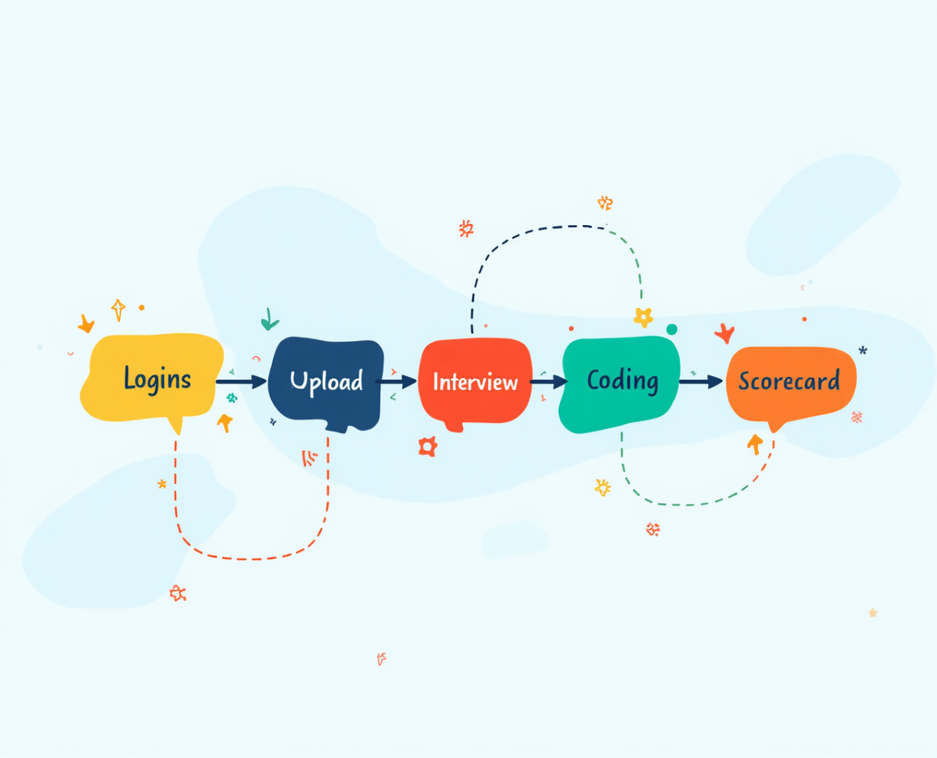
InterviewIQ AI
Page 6 of 10
🔄 Process Flow
🎙️ Voice Processing
🔐 Login
↓
👤 Select Role
↓
📄 Upload Resume
↓
🎤 AI Voice Interview
↓
💻 Coding / DevOps Challenge
↓
🤖 AI Evaluation
↓
📊 Scorecard
↓
🛣️ Learning Roadmap
🎙️ Mic Input
↓
Web Speech API
↓
Transcript Text
↓
Gemini AI Processing
↓
📊 Confidence Score
↓
💬 Instant Feedback
Workflow
AI powers every stage of the interview journey—from resume parsing and real-time voice analysis to personalized feedback and a custom learning roadmap—delivering a realistic interview experience that helps candidates improve with every session.

Slide 7

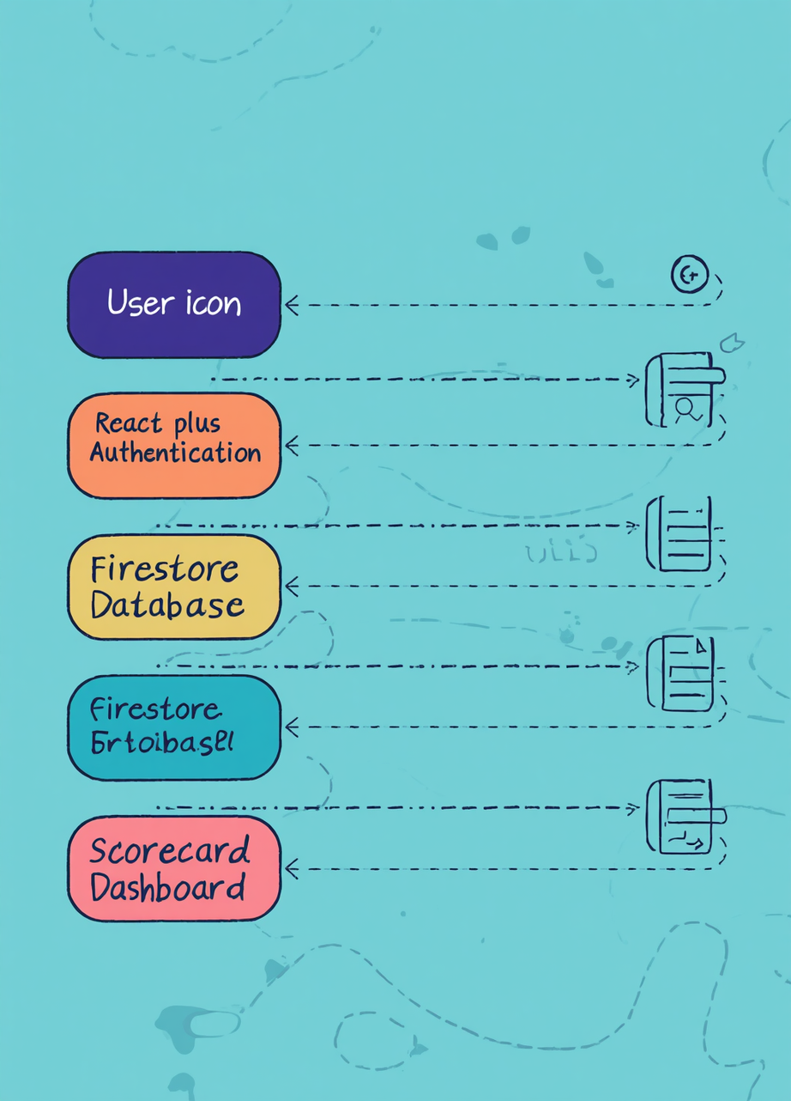


InterviewIQ AI
Page 7 of 10
Architecture
Diagram
Architecture diagram of the proposed solution
User → React + Tailwind → Firebase Auth → Firestore DB → Gemini API → AI Evaluation Engine → Scorecard & Dashboard
Each layer connects via REST/WebSocket with real-time sync through Firebase and AI inference via Gemini API.

Slide 8

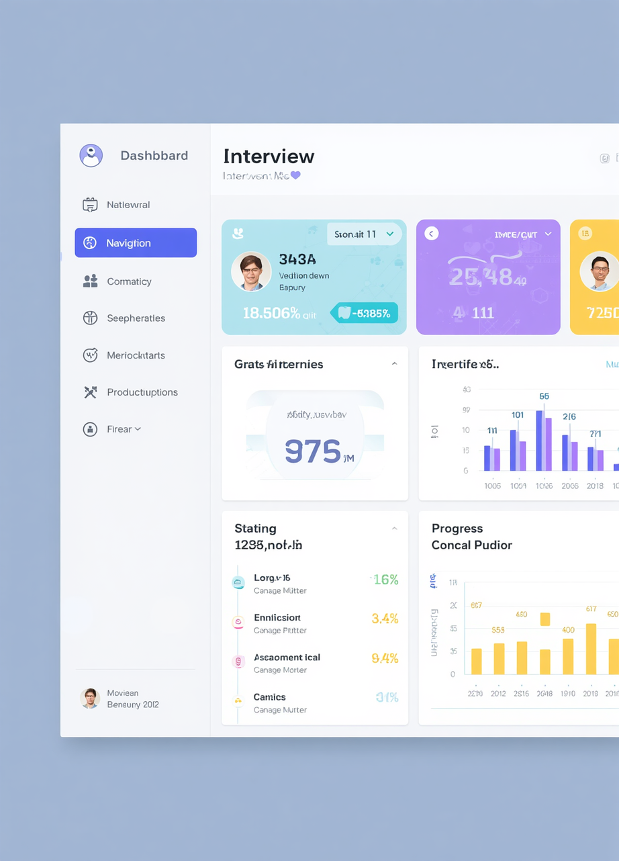

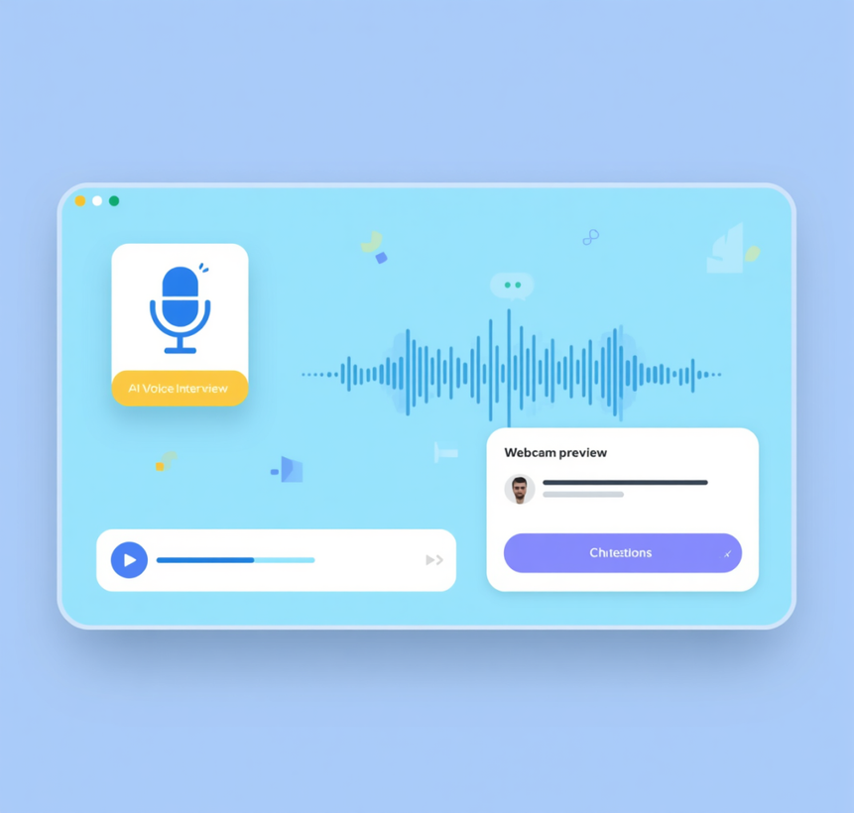
InterviewIQ AI
Page 8 of 10
Snapshots of the MVP
🖥️ Dashboard • 🎤 AI Voice Interview
📄 Resume Upload • 🐳 DevOps Terminal
📊 Analytics Dashboard
Five core screens showcasing the full InterviewIQ AI experience — from onboarding to performance insights.

Slide 9







InterviewIQ AI
Page 9 of 10
Provide Links to Your:
Scan the QR codes below to explore the project. Each link opens a key resource from the InterviewIQ AI hackathon submission.
GitHub Public Repository
Demo Video Link
Live MVP Link

Slide 10



InterviewIQ AI
Page 10 of 10
Thank You!
Questions? Let's connect! 🤝
📧 Email: your.email@example.com
🐙 GitHub: github.com/vineetsaini

